Slide 1


Tool Calling
Hector Triana

Slide 2
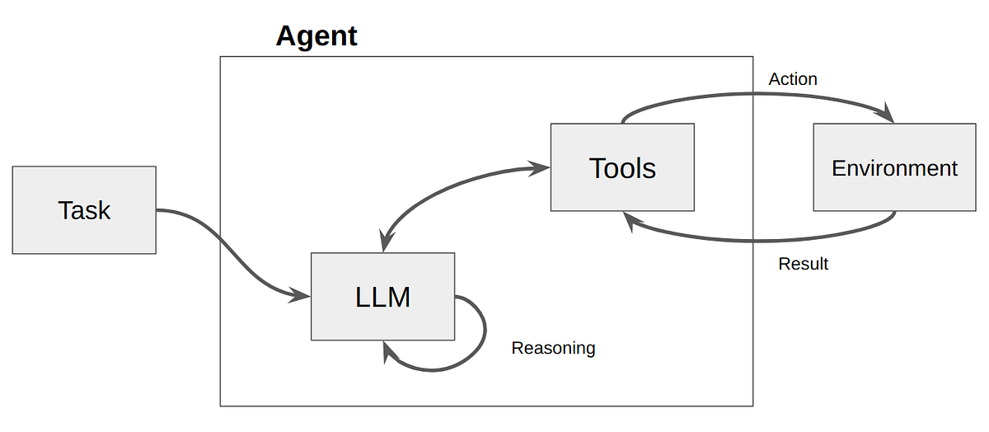
Tool Calling
Tool calling allows an LLM to interact with external tools during conversation generation. This means the LLM can access information or perform actions beyond its own knowledge base. Tools can be functions written by developers, APIs for external services, or any resource the LLM can interact with. AI agents have evolved from simple prompt-response systems into intelligent, action-oriented systems capable of interacting with APIs, databases, and external tools.

Slide 3
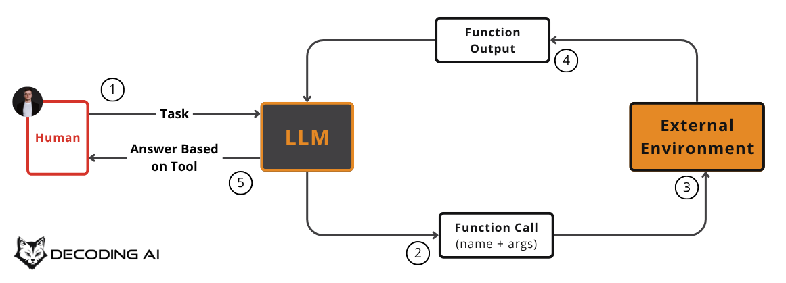
Instead of relying solely on pretrained knowledge, an AI system with tool-calling capabilities can query databases, fetch real-time information, execute functions or perform complex operations beyond its native capabilities.
Tool calling, sometimes referred to as function calling, is a key enabler of agentic AI. It allows autonomous systems to complete complex tasks by dynamically accessing and acting upon external resources.
AI agents have evolved from simple prompt-response systems into intelligent, action-oriented systems capable of interacting with APIs, databases, and external tools. This capability is known as tool-calling.
At its core, tool-calling allows an AI agent to:
Retrieve real-time data
Perform computations
Execute workflows
Interact with external systems

Slide 4
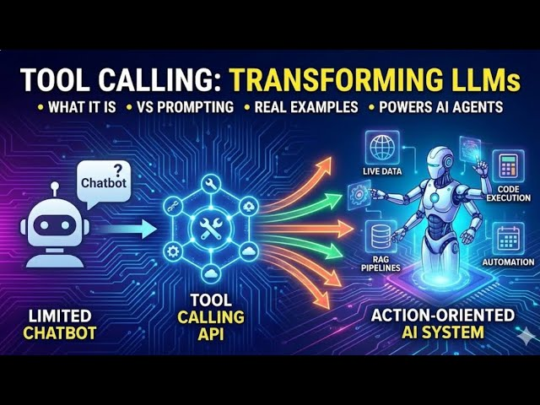
How to Achieve Tool Calling
Define Your Tools:
Write functions representing the tools you want the LLM to use.
These functions should be well-defined with:
Descriptive names
Type hints for arguments (e.g., a: float)
Docstrings explaining function purpose and arguments (using Args: block).
Optional return type and Returns: block.
Prepare the Conversation:
Create a list containing your tool functions.
Set up the conversation history as a list of dictionaries. Each dictionary should include:
"role" (e.g., "system", "user")
"content" (the text spoken by that role)
Pass Tools to the LLM:
Use a library function to format the conversation history and tool list for the LLM.
This function might take additional arguments like chat_template (specifying the tool calling template) and add_generation_prompt (to guide the LLM).

Slide 5
Interpret LLM Output:
After processing the conversation and tools, the LLM might suggest tool calls.
These calls are usually formatted as JSON objects with:
"name" (the tool function name)
"arguments" (a dictionary containing arguments for the tool)
Execute Tool Calls:
Parse the LLM’s tool call suggestion and extract the function name and arguments.
Call the corresponding function from your tool list with those arguments.
Incorporate Tool Results:
Capture the results returned by the tool functions.
Add these results to the conversation history for further processing by the LLM.
Continue Conversation:
Repeat steps 3–6 to allow the LLM to potentially use more tools based on the updated conversation history.

Slide 6
What is Tool-Calling in AI Agents?
Tool-calling refers to the ability of an AI model to:
Understand user intent
Decide whether a tool is needed
Select the correct tool
Pass structured arguments
Execute the tool
Interpret the result
Why Architecture Patterns Matter?
Without structure, tool-calling systems become:
Hard to debug
Non-deterministic
Difficult to scale
Error-prone
Architecture patterns provide:
Clear separation of concerns
Predictable execution flow
Better observability
Easier extensibility

Slide 7
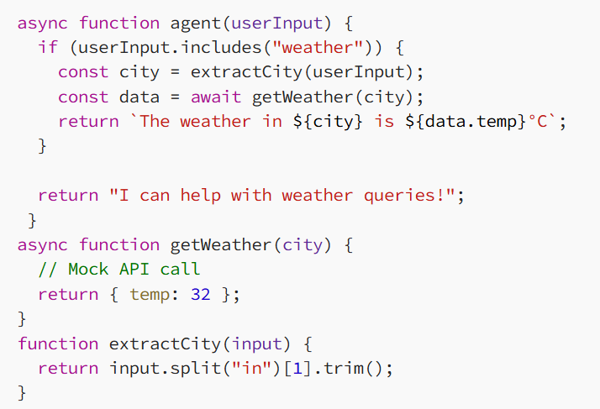
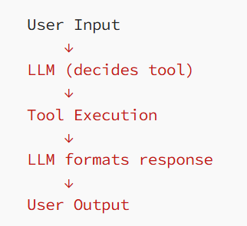
Core Tool-Calling Architecture Patterns
Single-Step Tool Calling (Basic Pattern)
The simplest pattern:
LLM decides → calls tool → returns response
Explanation
Intent detection is manual
Tool selection is hardcoded
No reasoning loop
Works for simple use cases
Limitations
Not scalable
Cannot handle multi-step reasoning
Tight coupling between logic and tools

Slide 8
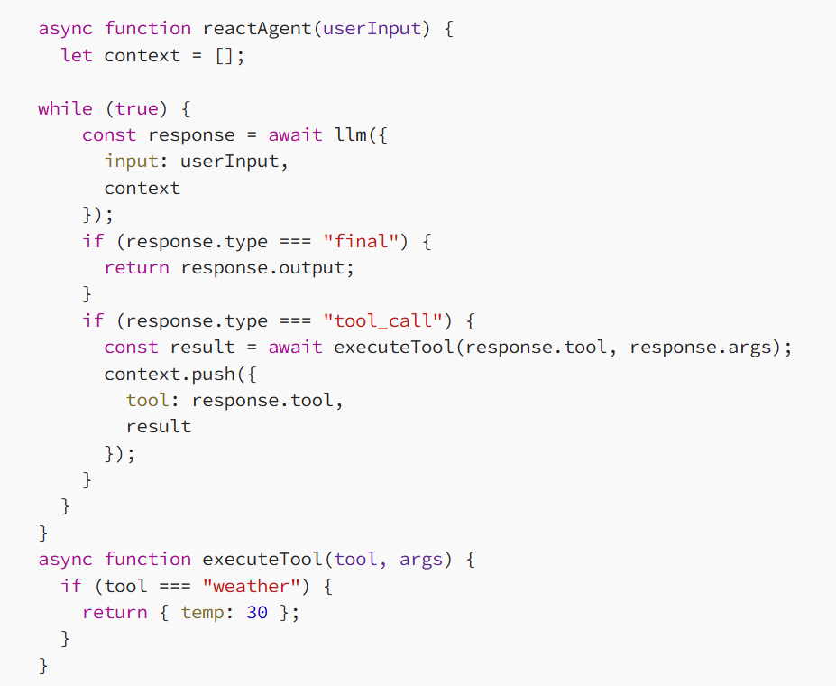
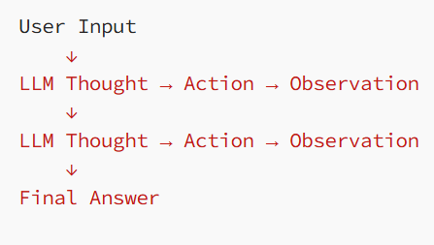
ReAct Pattern (Reason + Act)
The agent alternates between:
Reasoning (Thought)
Action (Tool Call)
Explanation
Intent detection is manual
Tool selection is hardcoded
No reasoning loop
Works for simple use cases
Limitations
Not scalable
Cannot handle multi-step reasoning
Tight coupling between logic and tools

Slide 9
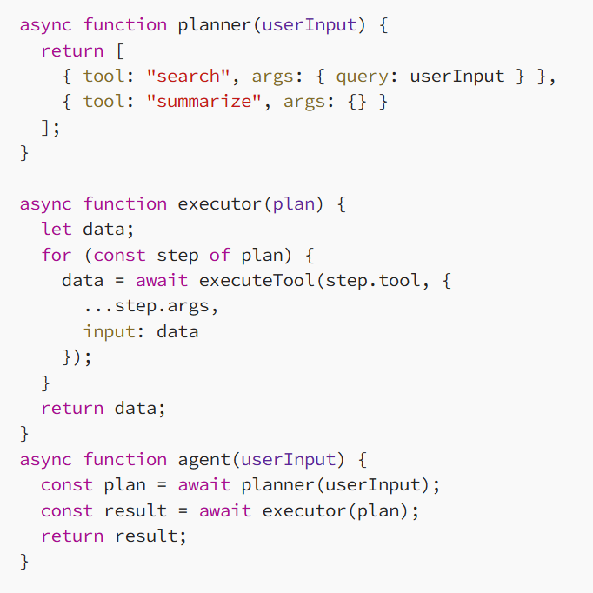
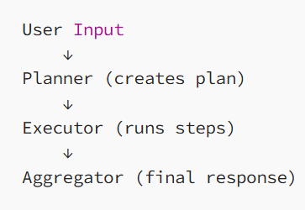
Planner-Executor Pattern
Split responsibilities:
Planner → decides steps
Executor → executes tools
Explanation
Planner creates a deterministic sequence
Executor runs steps sequentially
Clear separation of concerns
Drawbacks
Planner mistakes affect entire flow
Less adaptive mid-execution

Slide 10
Reference Links
https://www.ibm.com/think/topics/tool-calling
https://medium.com/@yasir_siddique/tool-calling-for-llms-a-detailed-tutorial-a2b4d78633e2
https://medium.com/@vasanthancomrads/tool-calling-architecture-patterns-for-ai-agents-91c82333d662

